Slide 1

EV Charging Station Availability Using Flask
Sneha Gupta 22107042
Priyal Madvi 22107020
Ayush Gupta 23207007
Rushikesh Palekar 23207004
Project Guide
Prof. Sheetal Jadhav

Slide 2
Outline
Introduction
Literature Survey of the existing systems
Limitations of the existing systems
Problem statement
System Design
Technologies and methodologies
Implementation
Conclusion
References

Slide 3
Introduction
User Authentication: Secure login for station operators and EV owners.
Charging Station Monitoring: Real-time status updates on availability and usage.
Booking System: Allows advance reservations to reduce wait times.
User Interface: Intuitive and responsive web design.
Mobile Compatibility: Accessible on mobile browsers for convenience.

Slide 4
Literature Survey of the existing system
Sr. No. | Year of Publication (Latest First) | Author(s) | Title | Observation
1 | 06 JUNE 2023 | Dr. Omar A. Ibrahim, Khalid J. Mohsen | Electric Vehicle Charging Station Finder App | We have observed that the EV charging station finder and slot booking app prioritize enhancing accessibility and convenience for electric vehicle users. The app offers comprehensive services, including locating charging stations and reserving slots, to address user needs effectively.

Slide 5
Literature Survey of the existing system
Sr. No. | Year of Publication (Latest First) | Author(s) | Title | Observation
2 | 30 November 2023 | ENEA C.R. Casaccia ,Andrenacci, N, Valentini, M.P | Charging behavior of electric vehicles | We observed that electric vehicle owners faced inconvenience due to the variety of battery types and charging requirements. Manual checking of charging stations for compatible connectors is time-consuming and adds complexity to the charging process.

Slide 6
Literature Survey of the existing system
Sr. No. | Year of Publication (Latest First) | Author(s) | Title | Observation
3 | 2023 | Vikas Mahala , Mansi Mutreja | Electric Vehicle and its impact on the distribution system | We observed to Implement a user feedback system within the application, allowing users to provide reviews and ratings for charging stations. Provide users with information on optimized charging schedules.

Slide 7
LIMITATION OF EXISTING SYSTEM
Booking System : The essential booking system for operations is currently down, posing a significant challenge until it's back online
Cancellation : Operational interruptions are still going on because there is no cancellation system, which in return obstructs management.
History: Operational setbacks arise from the absence of a history system, impeding access to vital records.
Payment : We cant download payment details.

Slide 8
Problem statement
To provide essential information such as charging station locations, availability, compatibility with various EV models, pricing details, and user reviews.
To ensure responsive design for easy access across devices.
To simplify the process of finding and utilizing charging stations.

Slide 9
System Design
Database Architecture: Plan the database architecture to store essential information such as charging station locations, availability status, pricing details, user reviews, and EV model compatibility.
User Authentication and Security: Design a secure authentication system to ensure user privacy and prevent unauthorized access.
Reservation System Design: Design a robust reservation system that allows users to book charging slots efficiently. Consider features such as booking and cancellation.
Improve the application interface for a seamless user experience, including real-time charging station status
Integrate secure mobile payment options, allowing users to seamlessly pay for charging services through the app.

Slide 10
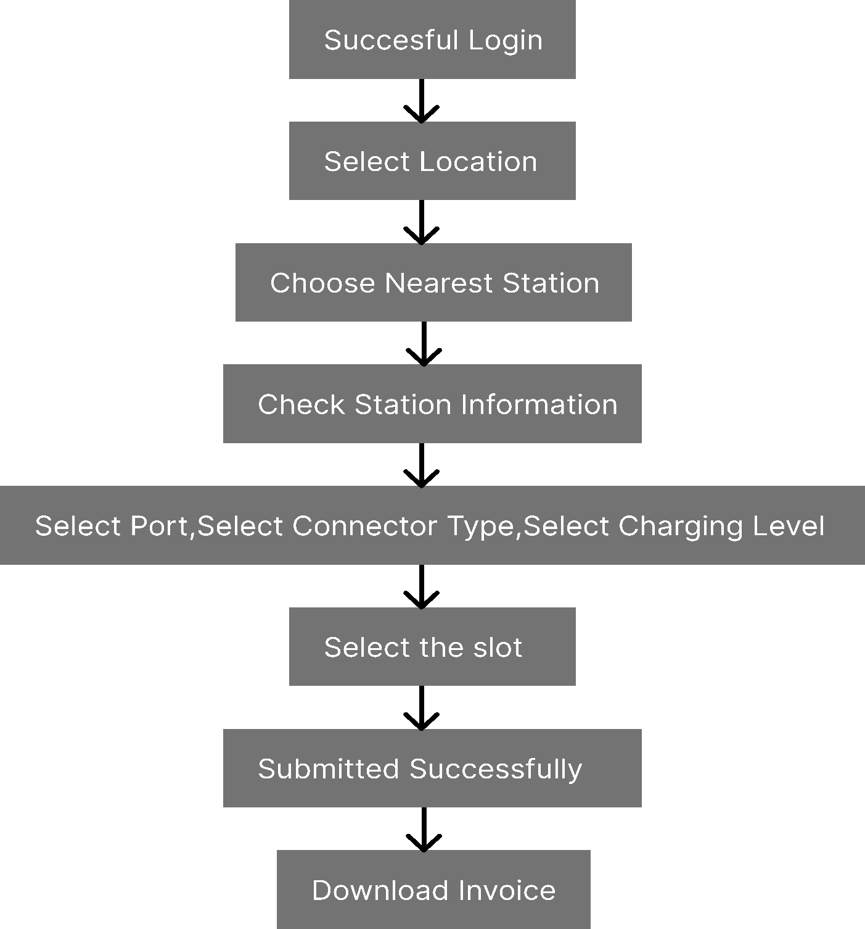
Technologies and methodologies

Slide 11
Implementation
Station Search and Booking Feature: Design a search functionality for EV owners to find nearby charging stations based on their location. Implement a booking system allowing users to reserve available charging slots at selected stations.
Invoice Generation and Download: Develop a feature to generate invoices for booked charging sessions, including details such as date, time, duration, and cost. Enable users to download invoices in a printable or digital format for their records.

Slide 12
Conclusion
Objective: Enhancing EV infrastructure by improving charging station availability.
Approach: Strategic placement and optimization to meet growing demand.
Outcome: Increased accessibility of EV charging despite challenges.
Impact: Positive contribution to sustainable transportation and EV adoption.
Challenges: Regulatory hurdles, limited funding, stakeholder coordination.

Slide 13
References
Ibrahim Tumay Gulbahar , Muhammed Sutcu , Abedalmuhdi Almomany and BabulSalam KSM Kader Ibrahim, Optimizing Electric Vehicle Charging Station Location on Highways: A Decision Model for Meeting Intercity Travel Demand, 11 December 2023
Fareed Ahmad , Atif Iqbal , Imtiaz Ashraf , Mousa Marzband , Irfan khan , Optimal location of electric vehicle charging station and its impact on distribution network,Volume 8, Pages 2314-2333, November 2022
https://www.sciencedirect.com/science/article/pii/S2352484722001809
https://www.mdpi.com/2071-1050/15/24/16716

Slide 14
Thank You...!!

